Slide 1
Design for Verification Project Update
2021-05-03
Eldrick Millares, Jack Humphries (eldrick, jhumphri@stanford.edu)

Slide 2
Recap:
Completed Deployment on Steel (simple design)
Ongoing Deployment on BOOM (complex design)

Slide 3
Steel Demo - Current Status
All instructions in current SQED generator supported (including load / store)
No counterexamples
Except for when the qed_i_cache eventually gets full and can no longer buffer incoming original instructions

Slide 4
Steel Demo - Summary of Notable Modifications
Disabled CSR MIE
Shrunk Main Memory
Accounted for when `SW` commits in the pipeline
Accounted for multiple commits in one cycle
Accounted for pipeline flushes
Summary of above is in README of the steelcore_demo/ in the Github repo

Slide 5
Steel Demo - Next Steps
Enabling Control Flow Checking
Can formulate some assertions on the Instruction Address values based on the CFCSS-V and CFTSS-V QED tests
Further references to be found in David Lin’s dissertation
Want to modify SQED Generator to allow these instructions
Adding “Location-Specific SIF Commit Tracking” for Improving BMC Depth
Deals with cases where you have long pipelines where instructions commit at different points in the pipeline
Commit = last modification of architectural state by instruction
Requires special care in dealing with these scenarios, can decrease performance of technique if pipeline is long
Dynamically track when SIF instructions commit and make that location (Reg File, Memory) individually QED consistent

Slide 6
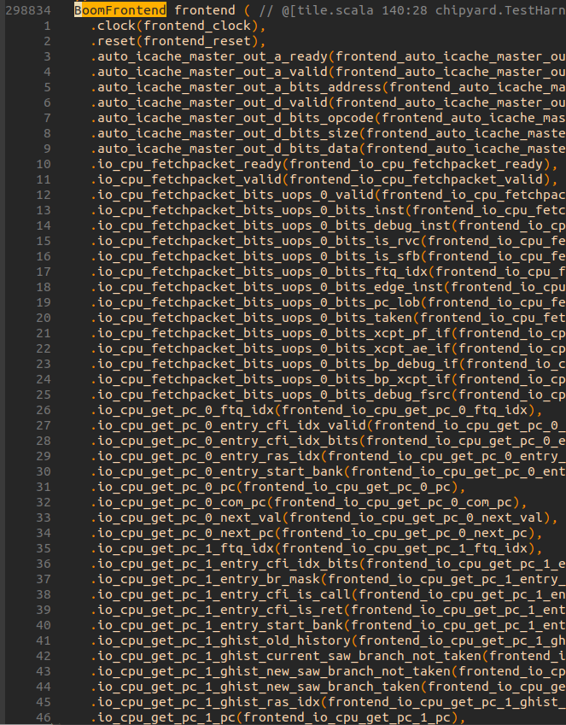
BOOM Demo - Current Status
Identified Signals of Interest
Instruction Bus
Register File Signals
Renaming Table
Designing logic to account for register renaming when checking register file consistency

Slide 7
Next Steps Summary
Extend ISA scope in SQED Generator / steel
Deploying QED module to generated BOOM verilog
Account for BOOM Register Renaming

